Slide 1
Capstone Spring 2018 Report
Ziyan Wang
Ankita Kalra

Slide 2
Problem setup
3D detection using point cloud data
Large scale scene
Sparse point cloud model
Fast search
Notes:
To start with, our goal is to perform 3D detection of certain objects located in a large scaled scene within a short period of time.

Slide 3
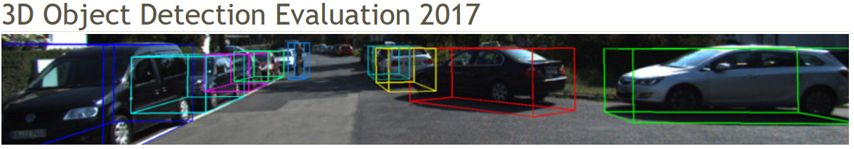
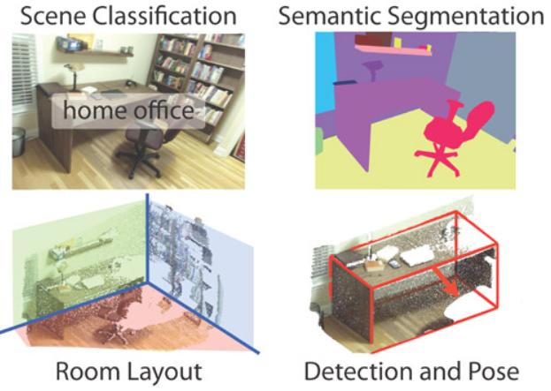
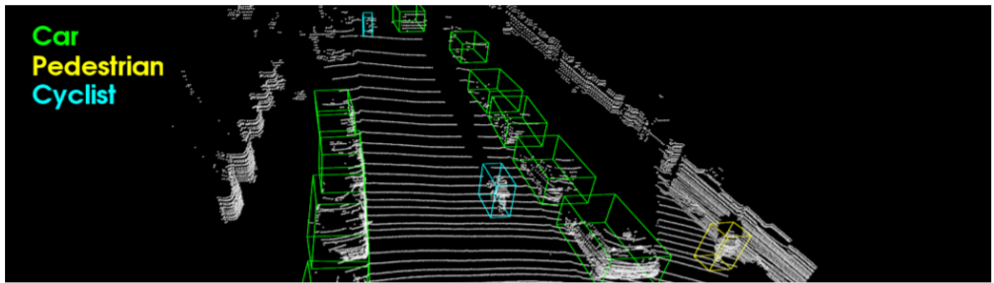
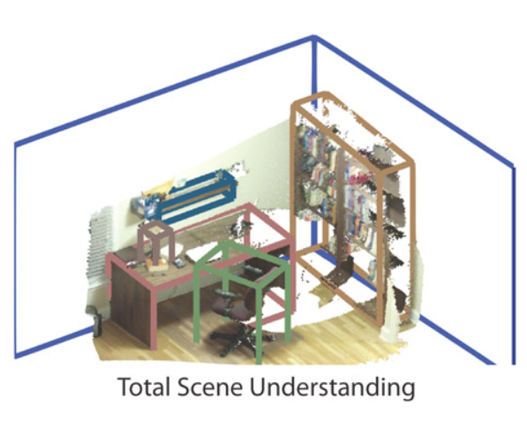
Benchmarks and Datasets
Kitti 3D detection
SUN RGB-D
Notes:
One of the most efficient way to store 3D informations is to use 3D point cloud. There are many existing datasets for 3D detection using point cloud data. However most of them don’t fulfill our needs. For example, Kitti 3D detection dataset provides 3d point clouds scanned from the front view or side view of a car, but they do not have point cloud data of a dense holistic scene. SUN RGB-D has point cloud with fine-grained 3D bounding box annotations, but they only have indoor scenes in small scale.

Slide 4
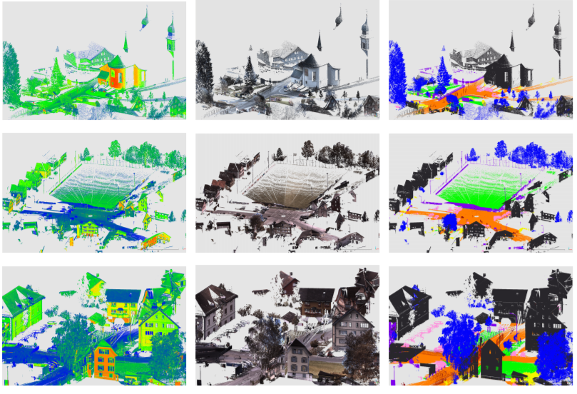
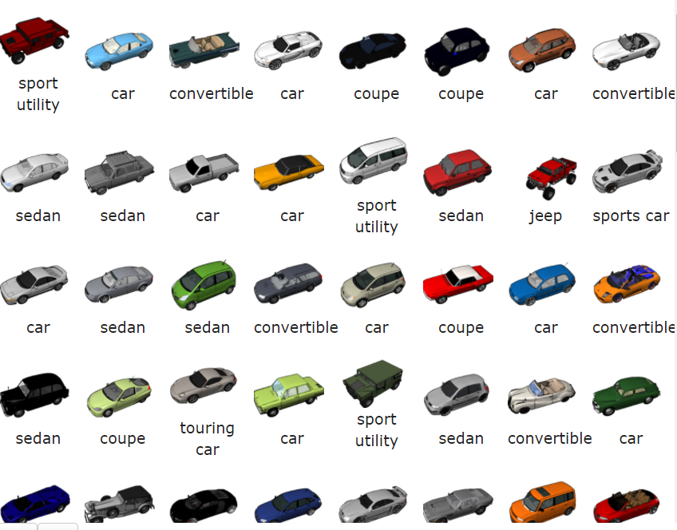
Benchmarks and Datasets
Semantic 3D
Dense scene
Large scale point cloud
ShapeNet
Numerous objects
Accurate 3D models
Notes:
Therefore, we created our own datasets using a combination of two 3D datasets, Semantic 3D dataset which contains large scaled scenes and Shapenet with numerous various objects and their shapes.

Slide 5
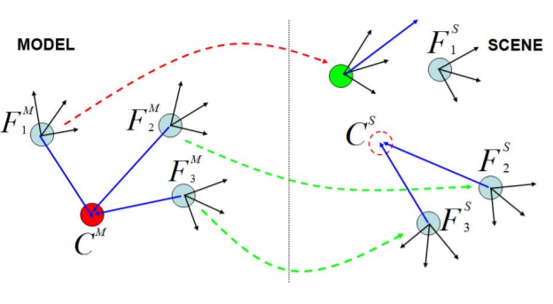
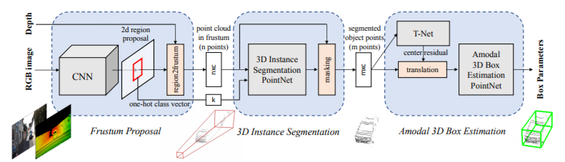
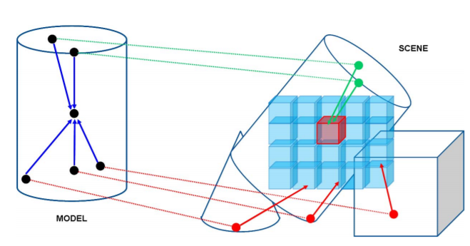
Methods
Deep learning
Proposal
Classification
Geometric
Geometric feature
Matching
Notes:
Recent years, there are two different kinds of methods that have been proposed in the field of 3D detection. The first kind is learning based method, or using deep learning methods. In their pipeline, they first generate proposals by learning a network to regress from either rgb or depth or point cloud to proposal. Then they use another network to perform classification on the extracted point cloud in proposals. Another school is using geometric methods where they first compute geometric feature for interesting points and then do matching between their templates and the target.

Slide 6
Methods
Deep learning
Generalizability
Data hungry
Large computation budget
Geometric
agnostic to shape
scalable
require target model
Notes:
Both of those methods have their strengths and shortcomings. For deep learning, it is generalizable, but it is also data hungry method and directly applying it to a large scene will give rise to large computation budget. For geometric methods, they are scalable and agnostic to shape. But those methods, in general, requires prior knowledge of target model.

Slide 7
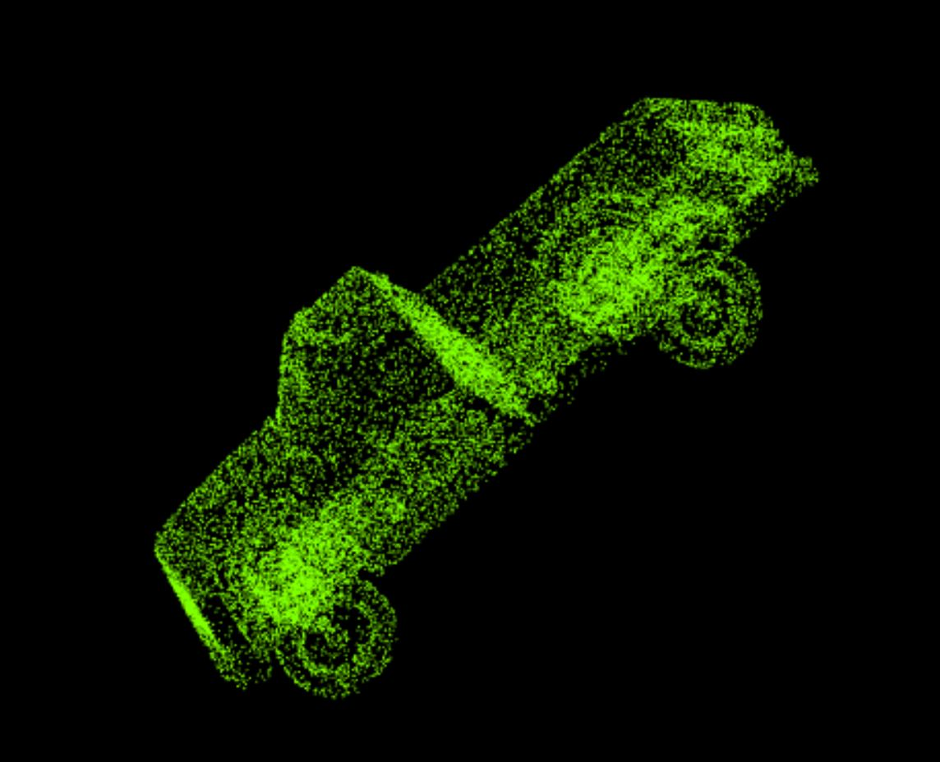
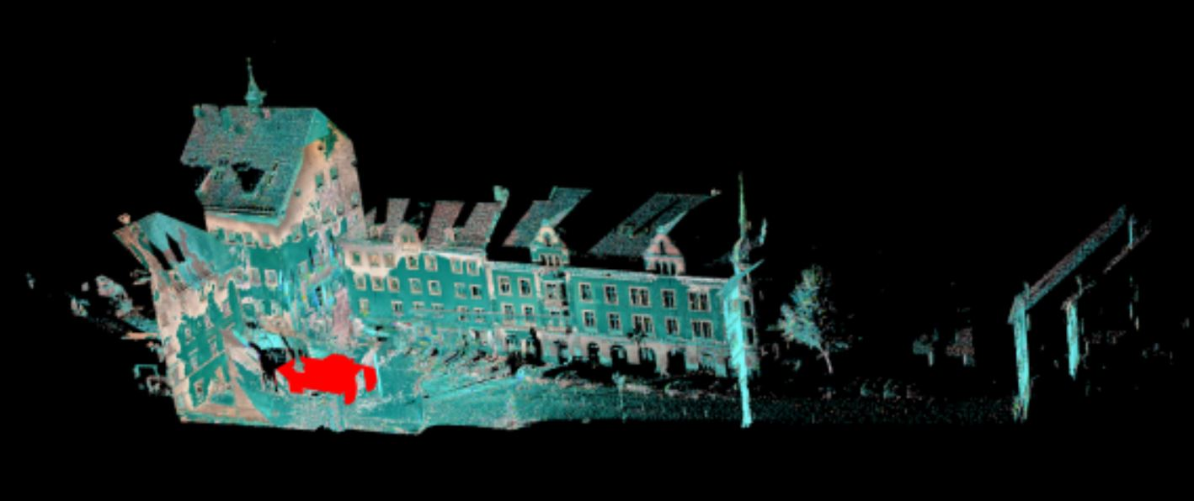
Data
visualization of data
car (model)
scene
Notes:
Here is a screen shot of our model. The left figures shows the model sampled from shapenet and the right figures shows the scene we sythesized by putting a car into semantic 3D dataset. The red points are from the car.

Slide 8
Data
Rotation
Down sampling
Occlusion
Segmentation
Notes:
To test the limitation of various methods, we try to augment our synthetic data by performing rotation, down sampling, adding occlusion and segment the target objects.

Slide 9
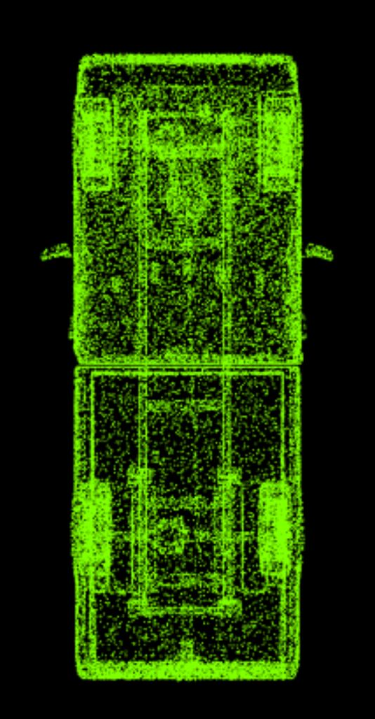
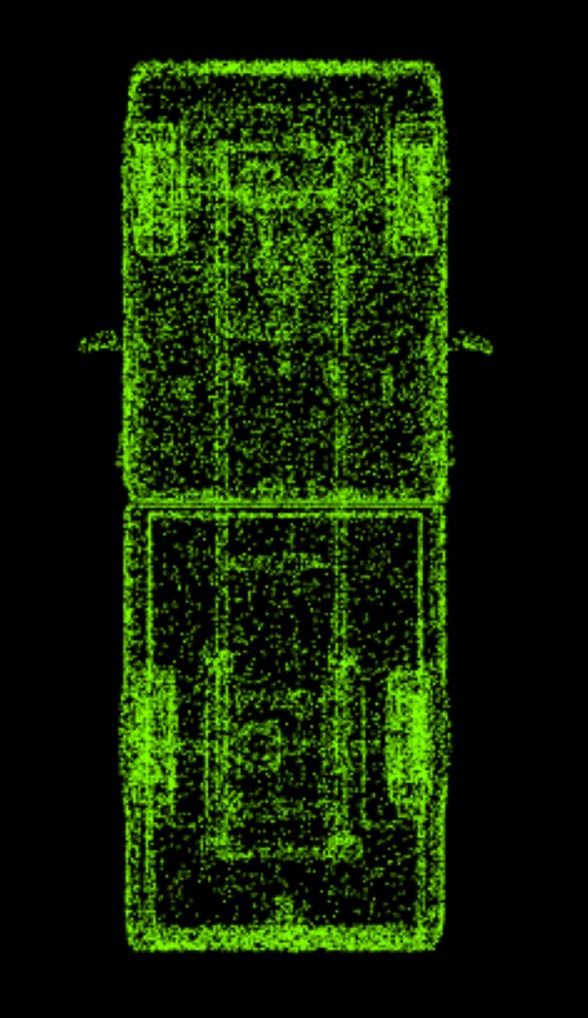
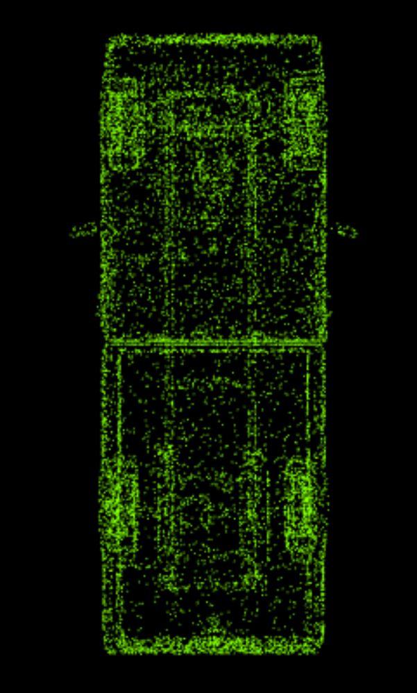
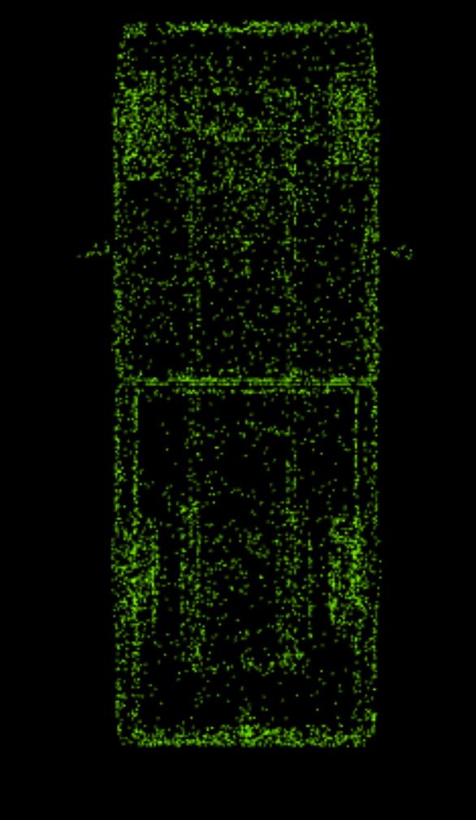
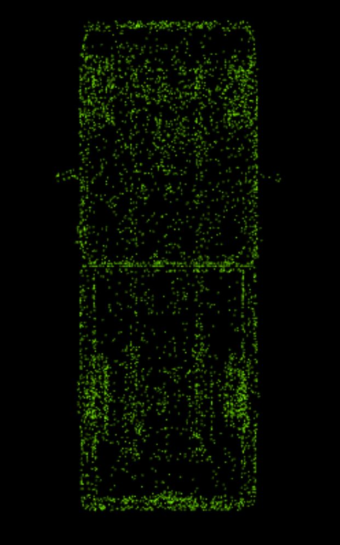
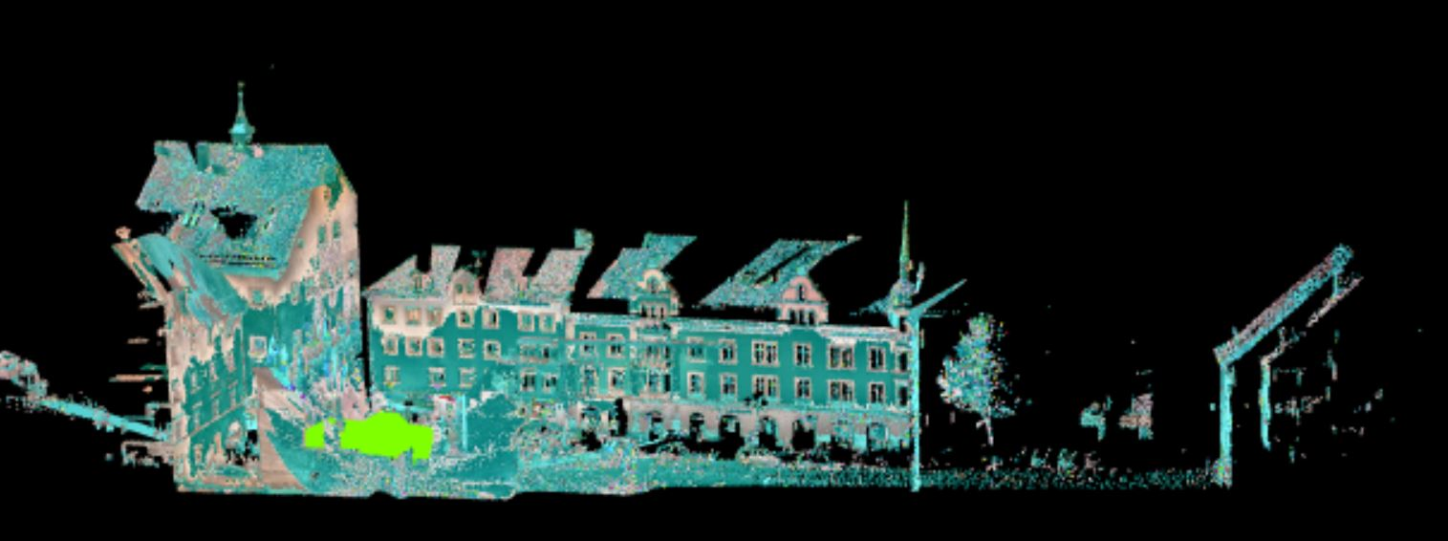
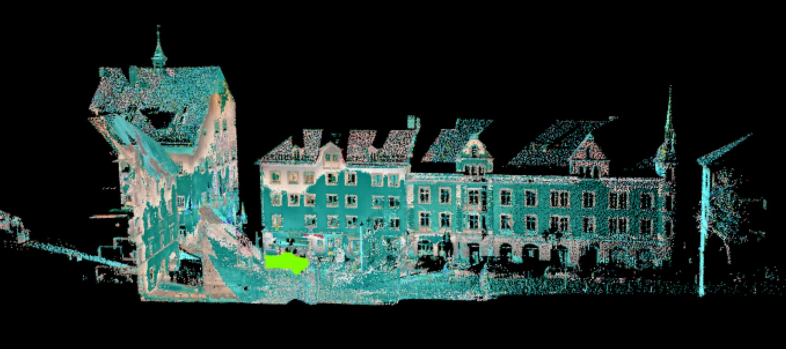
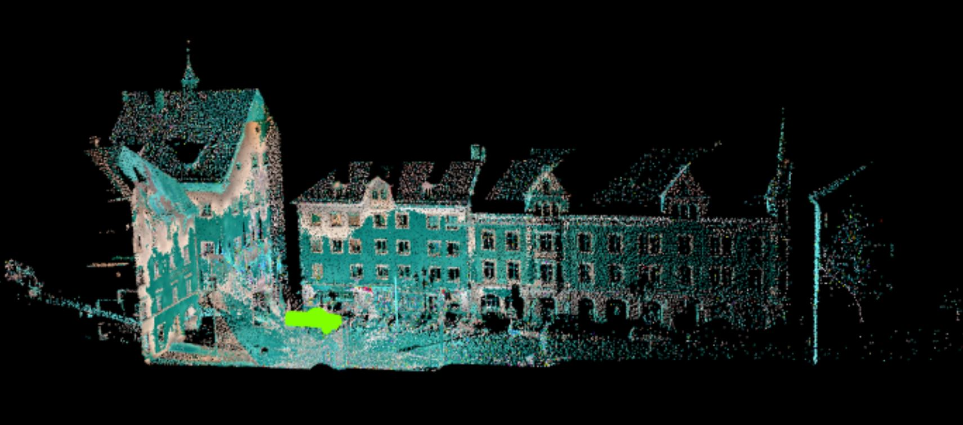
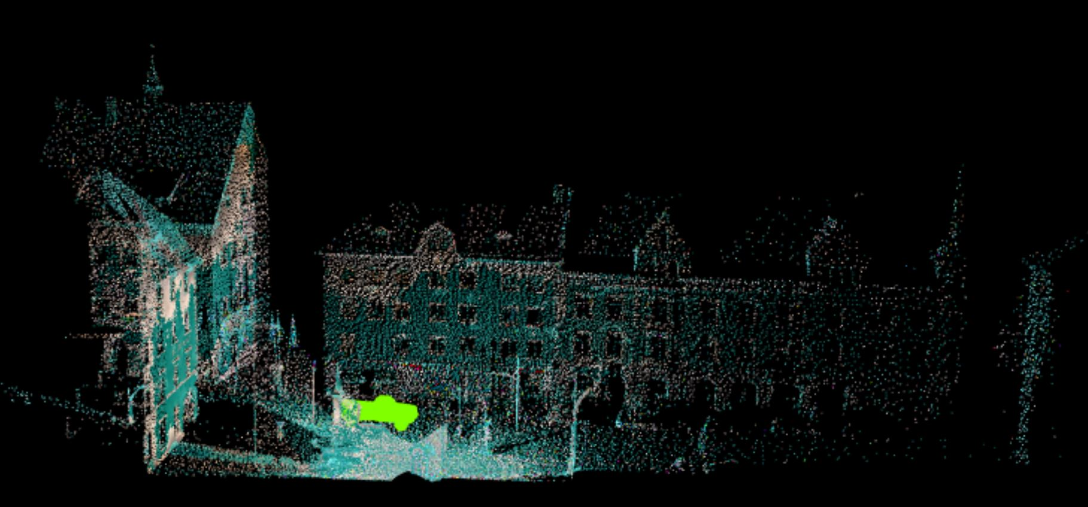
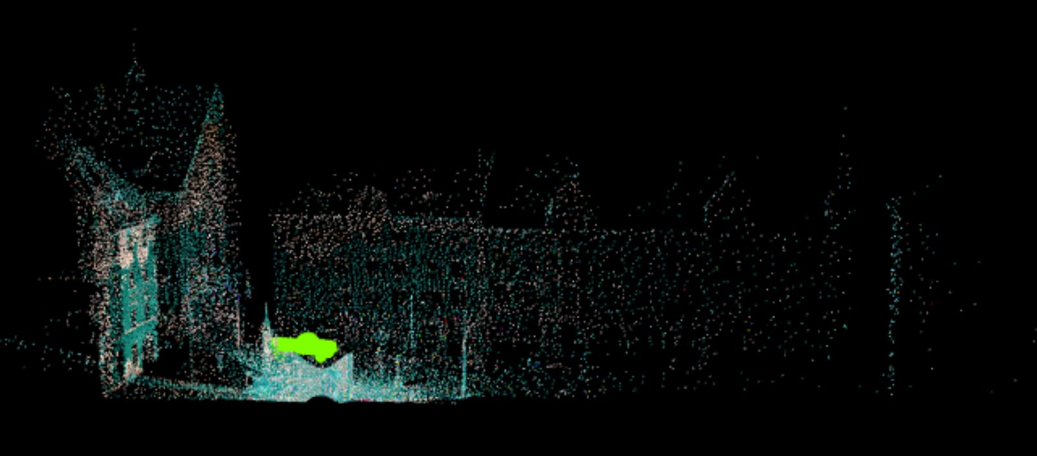
Down Sampling
Bottom-View of Car at different sampling ratios
Scene at different sampling ratios

Slide 10
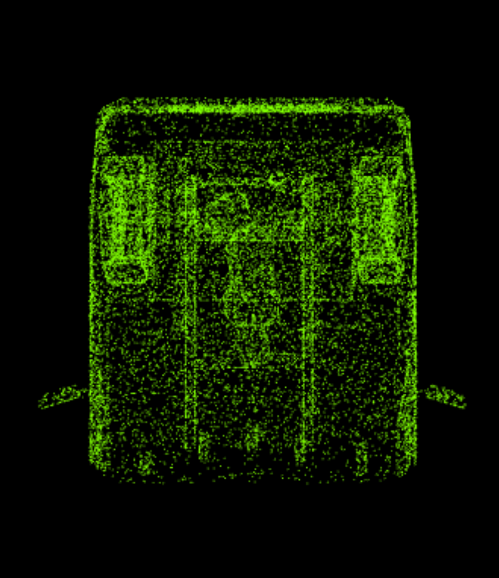
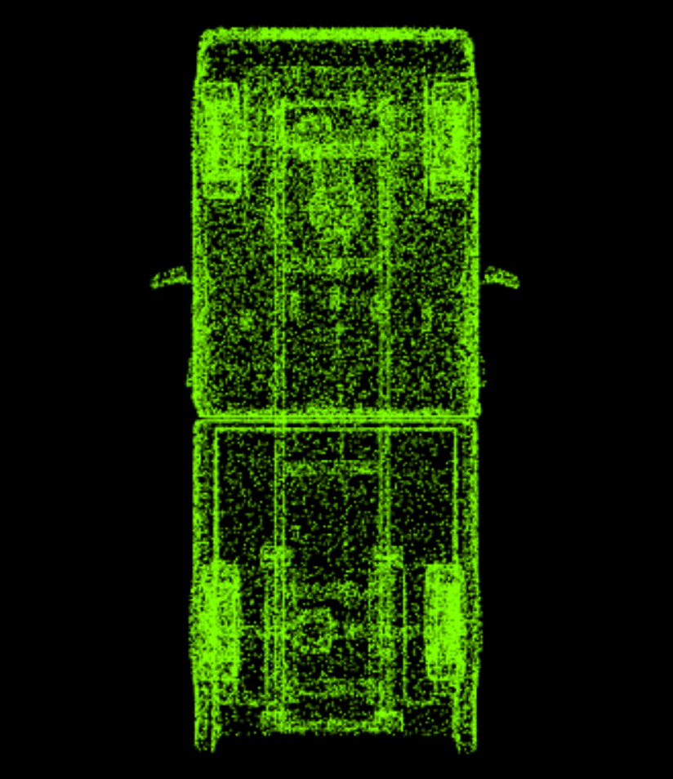
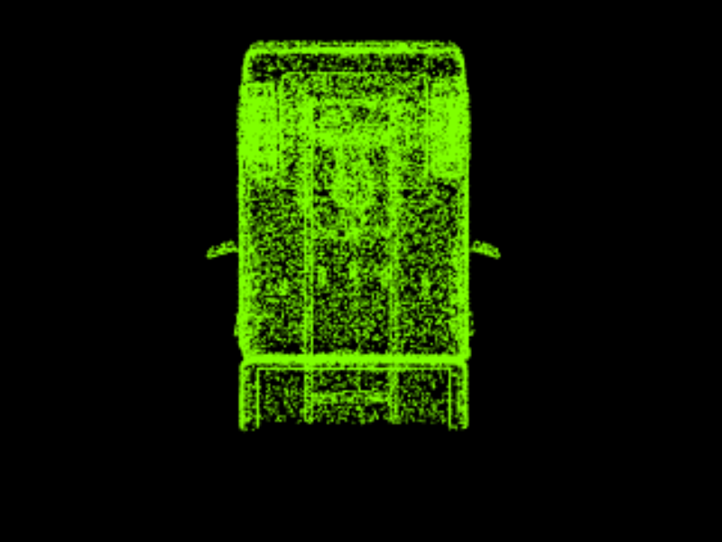
Segmentation

Slide 11
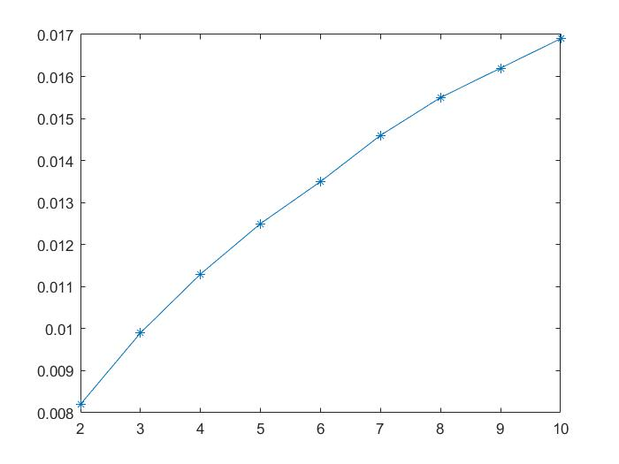
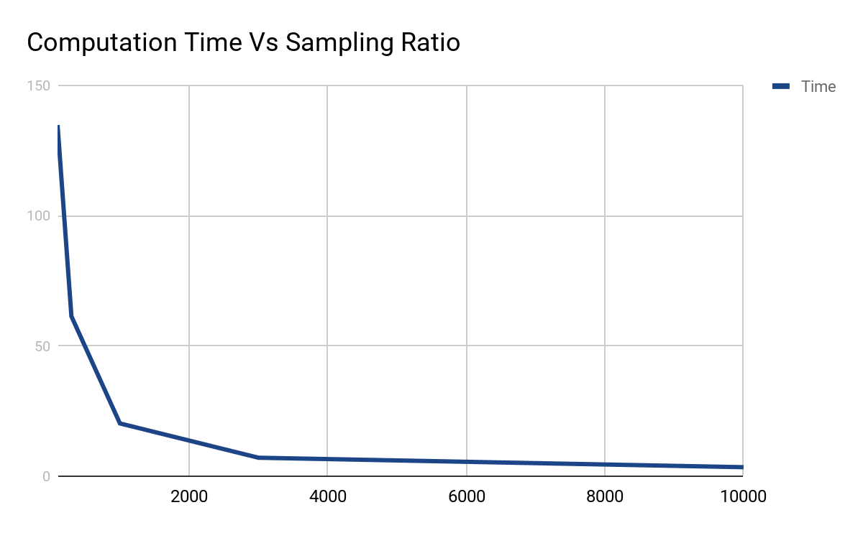
Down Sampling
Uniform sampling and Voxel Grid Sampling
Sampling ratio v.s. Mean minimum distance
distance
sampling ratio

Slide 12
Cars at Different Rotation

Slide 13
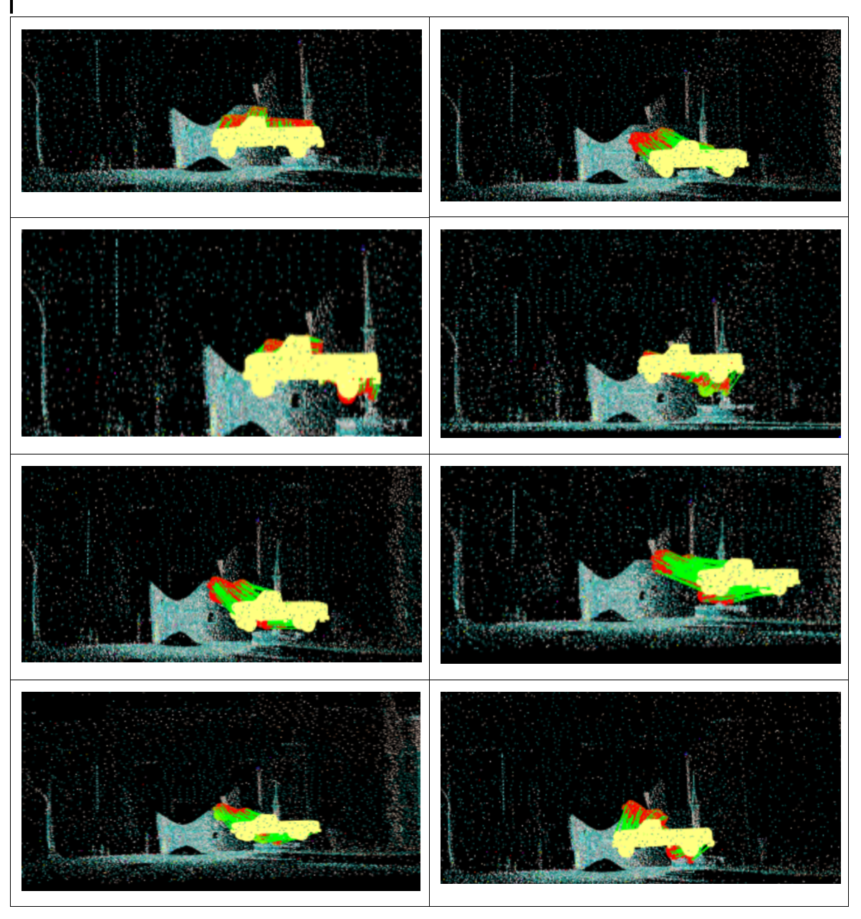
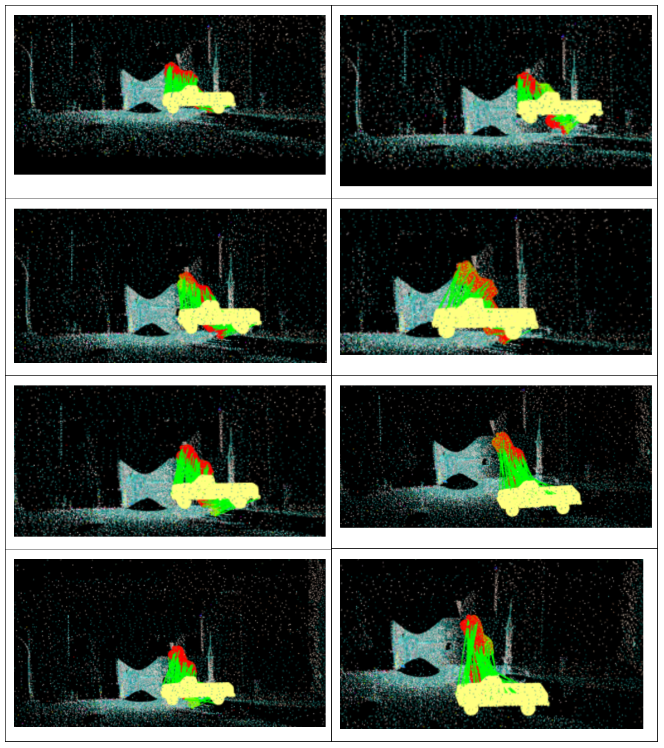

Slide 14
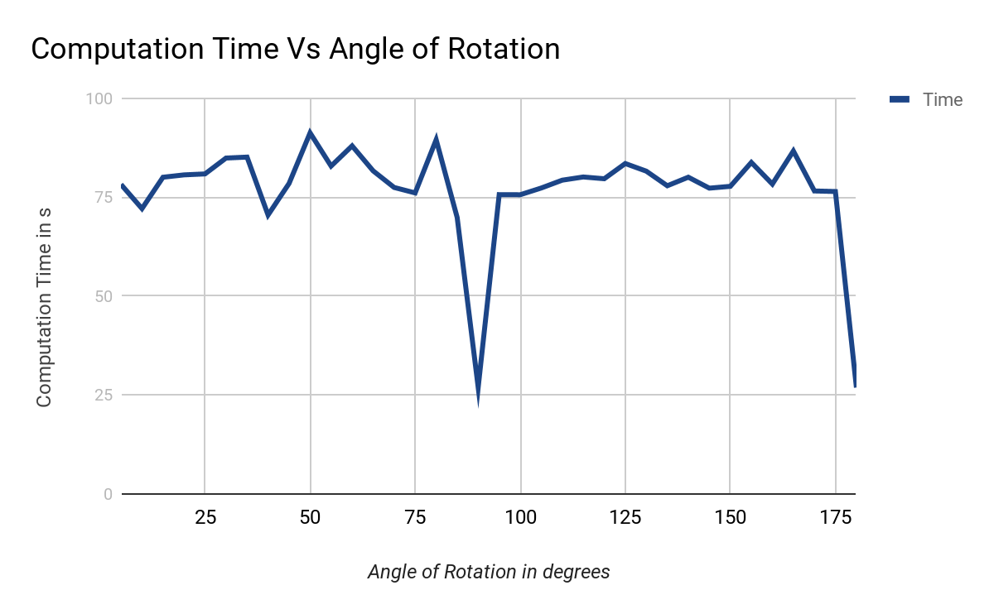
Computation Time vs Angle of Rotation of Car in Scene
Sampling Ratio of Car | 1
Sampling Ratio of Scene | 1000
Sampling Ratio of Car in Scene | 1
Angle of Car in Scene | Variable

Slide 15
Cars at Different Segmentation Cut

Slide 16
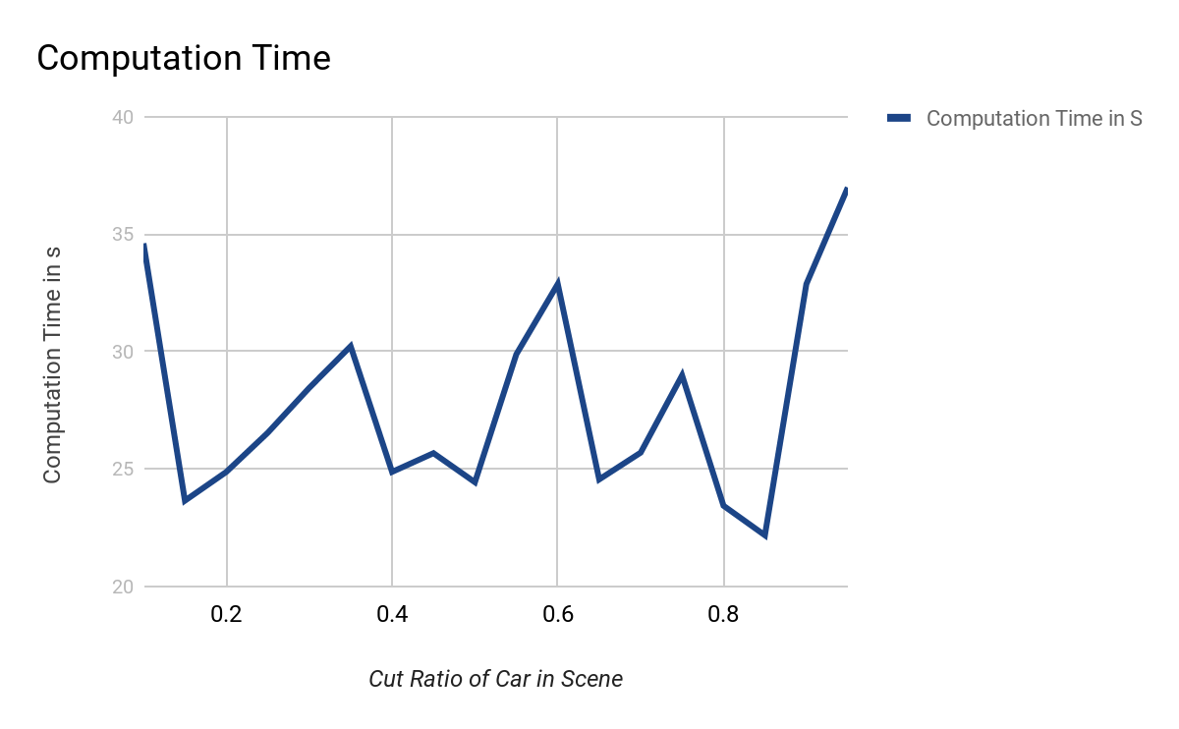
Overall Time vs Fraction of Car in Scene
Sampling Ratio of Car | 1
Sampling Ratio of Scene | 1000
Sampling Ratio of Car in Scene | 1
Cut Ratio of Car in Scene | Variable

Slide 17
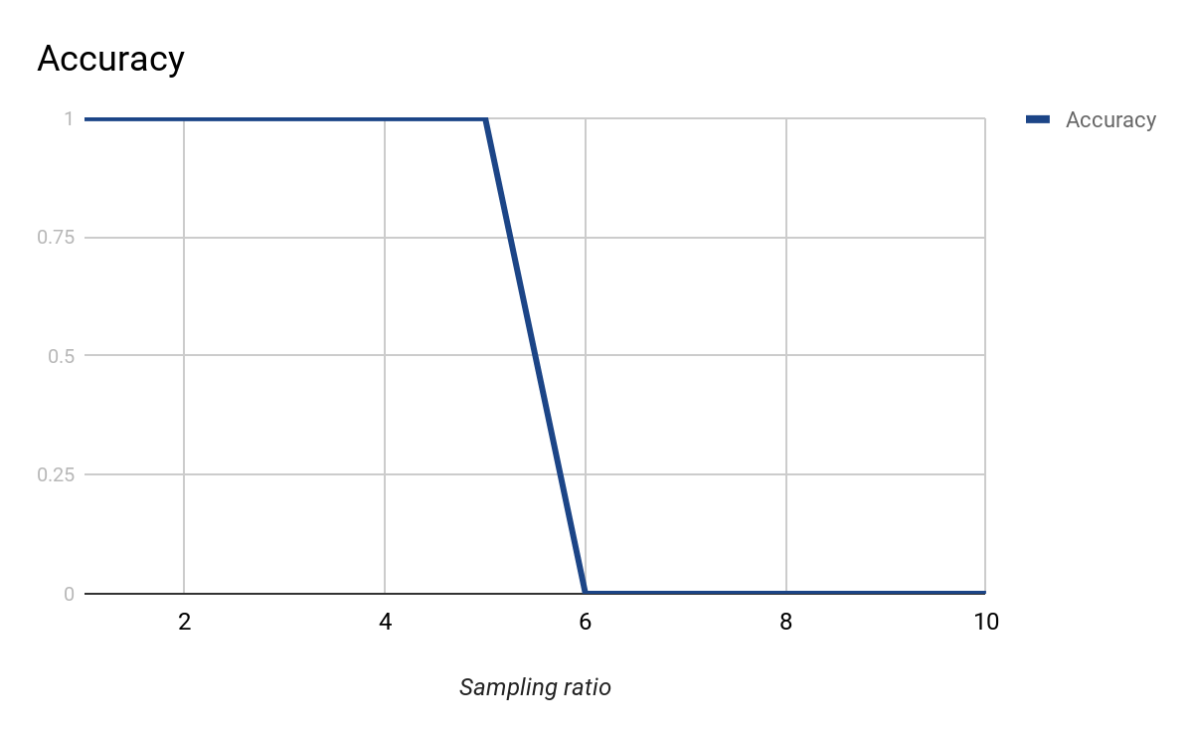
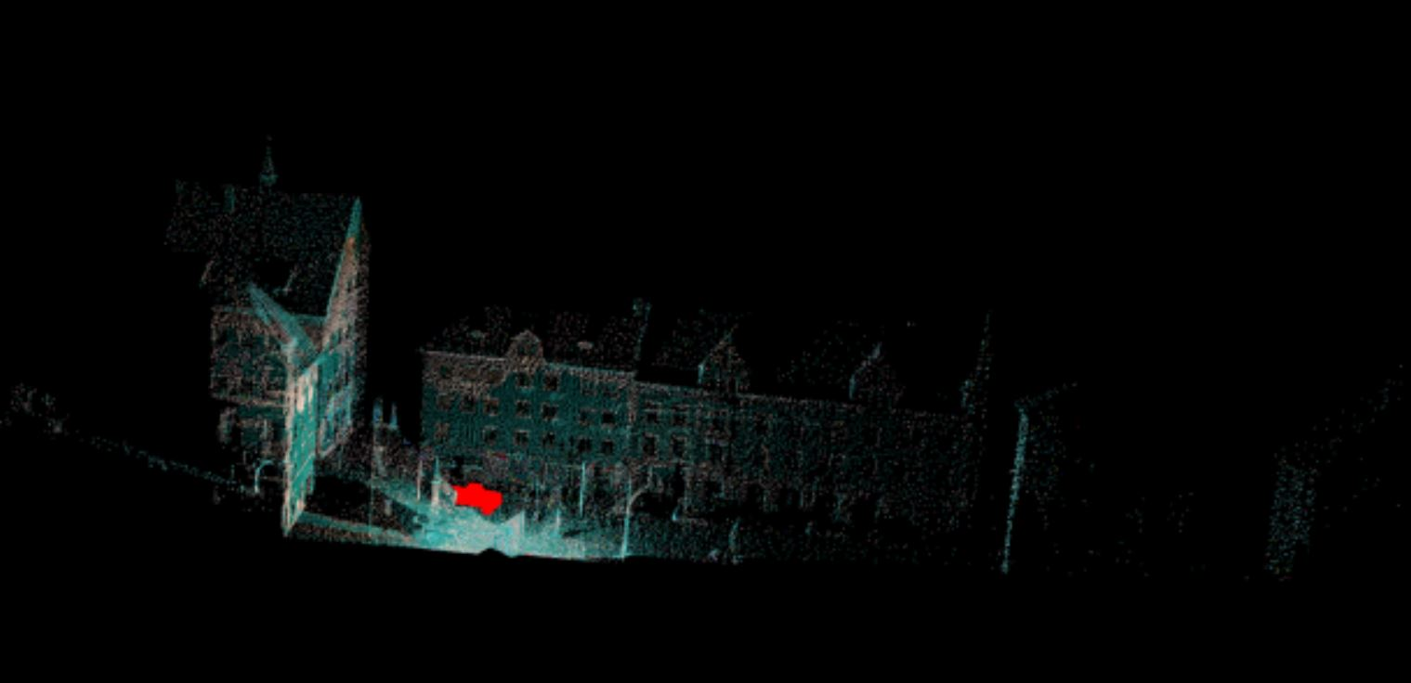
Sampling Ratio of Car in Scene and Model Car
results
detection: 1 car

Slide 18
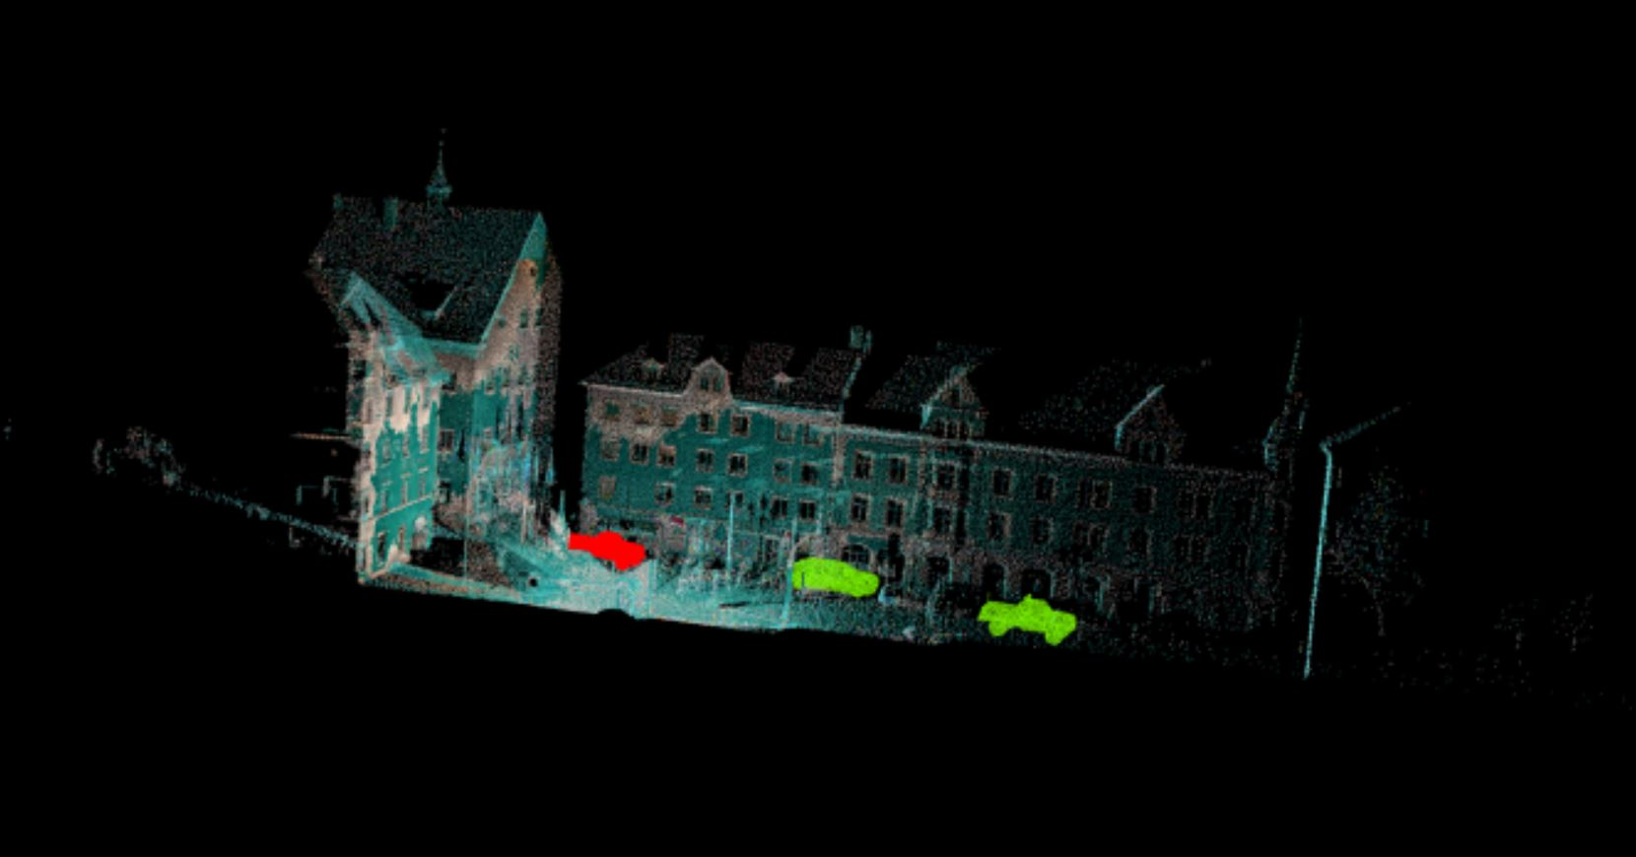
Sampling Ratio of Car in Scene and Model Car
results
detection: 3 cars

Slide 19
Conclusions
Future Work
SHOT descriptor based method is sensitive to downsampling
It is not sensitive to occlusion, segmentation and rotation.
Analyzing Deep Learning Methods on sparse data

Slide 20
THANKS!
Any questions?

